Slide 1
Machine Learning - 1
Unit 2

Slide 2
Unit 2

Slide 3
Spam filtering with logistic regression

Slide 4
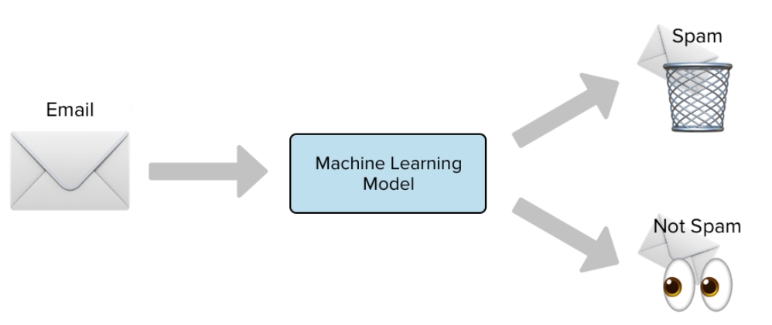
Spam filtering with Logistic Regression

Slide 5
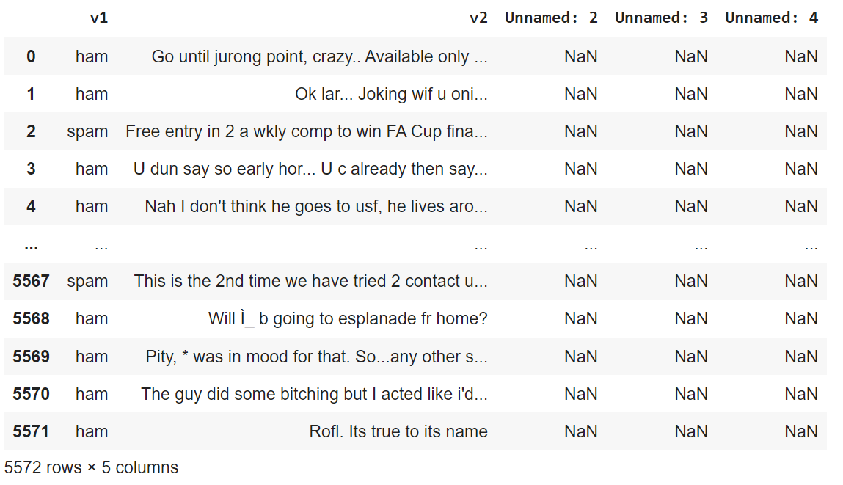
Spam Dataset – “Spam.csv”

Slide 6



“Spam.csv” - Description
Name: Spam.csv
Dataset size: 5572 rows × 5 columns
Colum1: v1 which describes whether the e-mail is a spam or a ham
Column2: v2 which has the content of the e-mail
Column3, column4, column5: unnamed 2 which has ‘NAN’ values

Slide 7

Spam filtering with Logistic Regression
Steps:
Data pre-processing - Preparing the text data by removal of punctuation and stop words
Vectorization - Collecting each word and its frequency in each email.
Splitting the dataset into training data and test data
Loading the classifier
Fitting / Training the model
Predicting the model
Computing accuracy

Slide 8
Spam filtering with Logistic Regression using Python
Reading dataset “spam.csv” and loading in a variable “message_data”
message_data = pd.read_csv("spam.csv",encoding = "latin")
Reading column v1 and v2 as ‘Spam/Not_Spam’ and ‘message’
message_data = message_data.rename(columns = {'v1':'Spam/Not_Spam','v2':'message'})
Step 1 : Data pre-processing on message text - removing punctuation and stop words
message_data_copy = message_data['message'].copy()
def text_preprocess(text):
text = text.translate(str.maketrans('', '', string.punctuation))
text = [word for word in text.split() if word.lower() not in stopwords.words('english')]
return " ".join(text)
message_data_copy = message_data_copy.apply(text_preprocess)

Slide 9
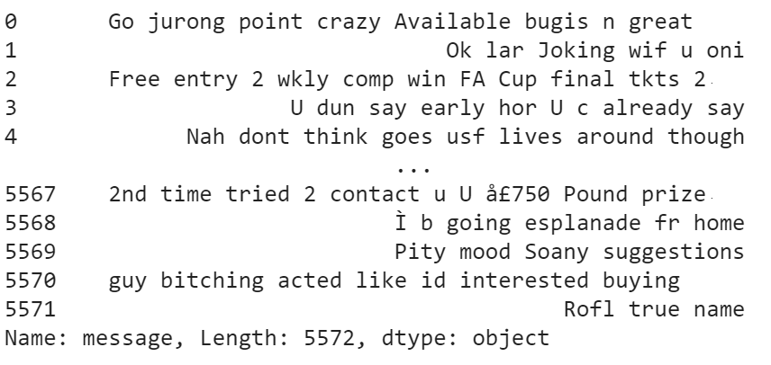
Spam filtering with Logistic Regression using Python
Dataset after pre-processing: No punctuation and full stop
Dropping column 3, 4, 5 which are not needed
message_data = message_data.drop(['Unnamed: 2', 'Unnamed: 3', 'Unnamed: 4'], axis = 1)

Slide 10
Spam filtering with Logistic Regression using Python
Step 2 : Vectorize the data : Collecting each word and its frequency in each email.
The vectorization will produce a matrix.
vectorizer = TfidfVectorizer("english")
message_mat = vectorizer.fit_transform(message_data_copy)
Step 3 : Splitting the dataset into ‘Train dataset’ and ‘Test dataset’
  Input training dataset ---> message_train
  Input test dataset ---> message_test
  Output training dataset ---> spam_nospam_train
  Output test dataset ---> spam_nospam_test
message_train, message_test, spam_nospam_train, spam_nospam_test =
train_test_split(message_mat,message_data['Spam/Not_Spam'], test_size=0.3, random_state=20)

Slide 11
Spam filtering with Logistic Regression using Python
Step 4 : Loading the Logistic Regression classifier
Spam_model = LogisticRegression(solver='liblinear', penalty='l1')
Step 5 : Training / fitting the model using Training dataset
Spam_model.fit(message_train, spam_nospam_train)
Step 6 : Predicting the model using testing dataset
pred = Spam_model.predict(message_test)
Step 7 : Computing accuracy of the model
accuracy_score(spam_nospam_test,pred)

Slide 12
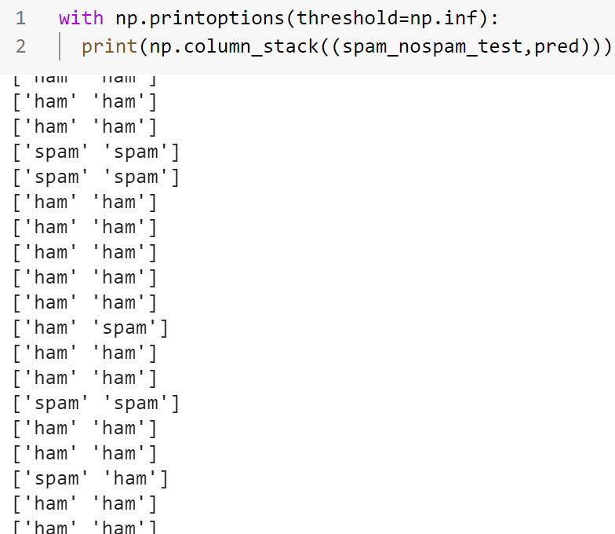
Spam filtering with Logistic Regression using Python
Output:
Column1 : From original dataset
Column2 : From ML model
Wrongly classified
‘ham’ predicted as ‘spam’
Wrongly classified
‘spam’ classified as ‘ham’

Slide 13
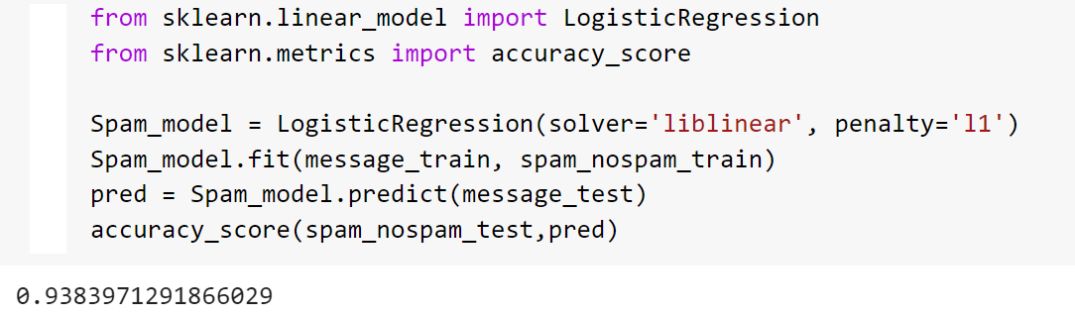
Spam filtering with Logistic Regression using Python
Output: Accuracy
Accuracy

Slide 14
Naive Bayes with scikit-learn

Slide 15


Naïve Bayes Classification
Naïve Bayes classification is a straightforward and powerful algorithm for the classification task.
Naïve Bayes classification is a supervised machine learning model.
Naïve Bayes classification is based on applying Bayes’ theorem with strong independence assumption between the features.
Naïve Bayes models are also known as simple Bayes or independent Bayes.

Slide 16
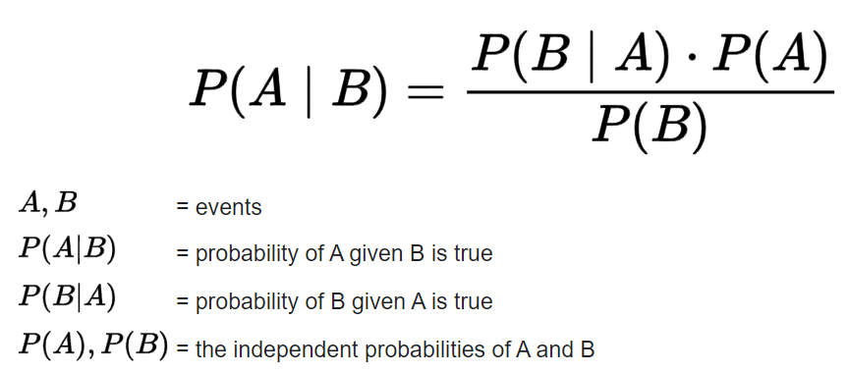
Naïve Bayes Classification
Bayes theorem is a formula which is given below. It describes how to update the probabilities of hypotheses when given evidence.
Where A is the ‘hypotheses’ and B is the ‘Evidence’

Slide 17
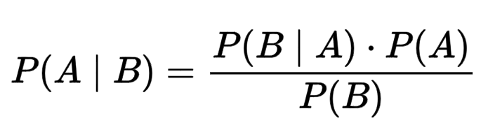
Naïve Bayes Classification
Bayes theorem vs Machine Learning
In machine learning,
A - - > Class label
B - - > Feature
P (A | B ) - - > Given a feature ‘B’, what is the probability that ‘B’ belongs to class ‘A’ ?
Note: In Naïve Bayes, features are independent

Slide 18
Naïve Bayes Classification
Example 1: Naïve Bayes with 1 feature and 1 class
A - - > Pneumonia (class)
B - - > Cough (feature)
Applying in Bayes theorem
P(Cough | Pneumonia) . P(Pneumonia)
P ( Pneumonia | Cough ) = ---------------------------------------------------------------
P(Cough)

Slide 19
Naïve Bayes Classification
Example 2: Naïve Bayes with 2 features and 1 class
A - - > Pneumonia (class)
B - - > Cough, Shortness of breath (features)
Applying in Bayes theorem
P ( Pneumonia | Cough, Shortness of breath ) =
P(Cough | Pneumonia) . P(Shortness of breath | Pneumonia) . P(Pneumonia)
---------------------------------------------------------------------------------------------------
P(Cough) . P(Shortness of breath )

Slide 20
Naïve Bayes Classification
When they are multiple features:
Features : X₁, X₂, X₃, ….. X_{N}
Class : y
Generalized formulae:
P(X₁ | y) . P(X₂ | y) … P(X_{N} | y) . P(y)
P(y | X₁, X₂, X₃, ….. X_{N}) = ------------------------------------------------------
P(X₁) . P(X₂) . P(X₃) … P(X_{N})
Likelihood
Prior class probability
Posterior Probability
Predictor prior Probability

Slide 21
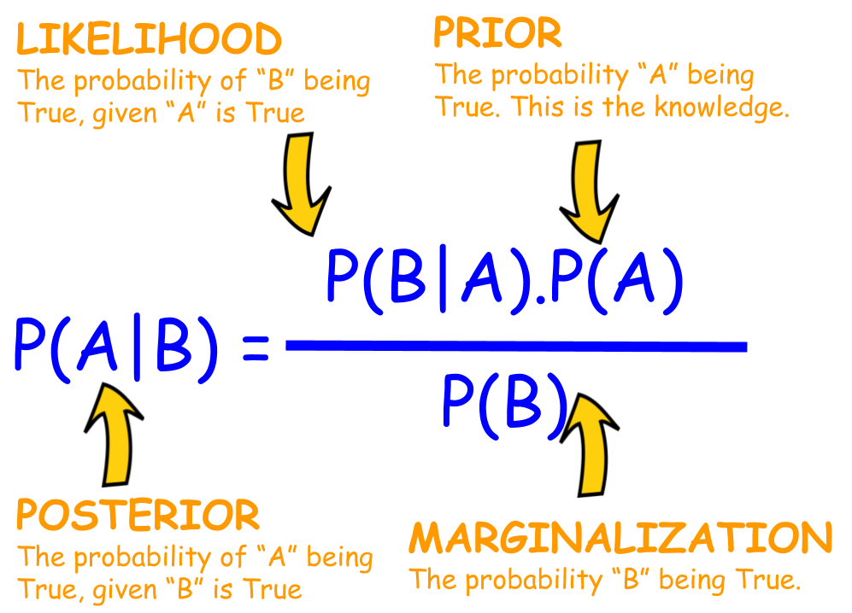
Naïve Bayes Classification

Slide 22
Naïve Bayes Classification - Example
Question: What is the probability that a patient has diseases meningitis with a stiff neck?
Given Data: Disease meningitis causes a patient to have a stiff neck, and it occurs 80% of the time. The Known probability that a patient has meningitis disease is 1/30,000. The Known probability that a patient has a stiff neck is 2%.
From the given data, we can calculate the following as:
P(a|b) = 0.8
P(b) = 1/30000
P(a)= .02
P(A|B) . P(B) 0.8 * (1/30000)
P(B|A) = ------------------ = --------------------- = 0.001333
P(A) 0.02

Slide 23
Summary

Slide 24
Thank You

